Slide 1
START
START
START
Ready to receive input
Ready to receive command
Send input (e.g.: ‘A1’ – ’10F’,
‘YO’)
Receive input?
No
Receive command?
No
Yes
Yes
Receive input
Receive command
If command == drop sensor status
Set command for motor dispensing
No
No
If command == ‘A1’ –’10F’
Yes
If input == ‘A1’ –’10F’
Ready to receive string
Yes
Receive string?
No
No
Check motor status
If input == ‘YO’
No
Yes
No
Yes
Motor available?
Receive string
Set command for drop sensor status
Get Temperature, Door Status
Yes
Motor ‘A1’ –’10F’ turns
Send info to MQTT
Send 6 bytes of Hex command
Yes
Check drop sensor status
Check drop sensor status
Ready to receive return Hex
Note: ‘YO’ is sent from DTU to STM32 via serial after user inputs ‘HI’ via MQTT protocol.
Receive return Hex?
No
Drop sensor available?
No
Yes
Yes
Receive return Hex
Drop sensor detects item?
No
Send string value
Process
Yes
DTU
STM32
Send 5 bytes of return Hex
STC BOARD

Slide 2
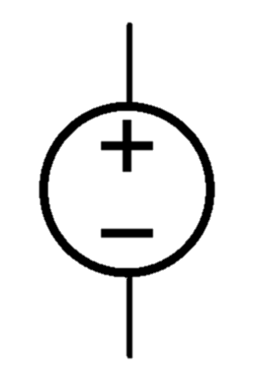
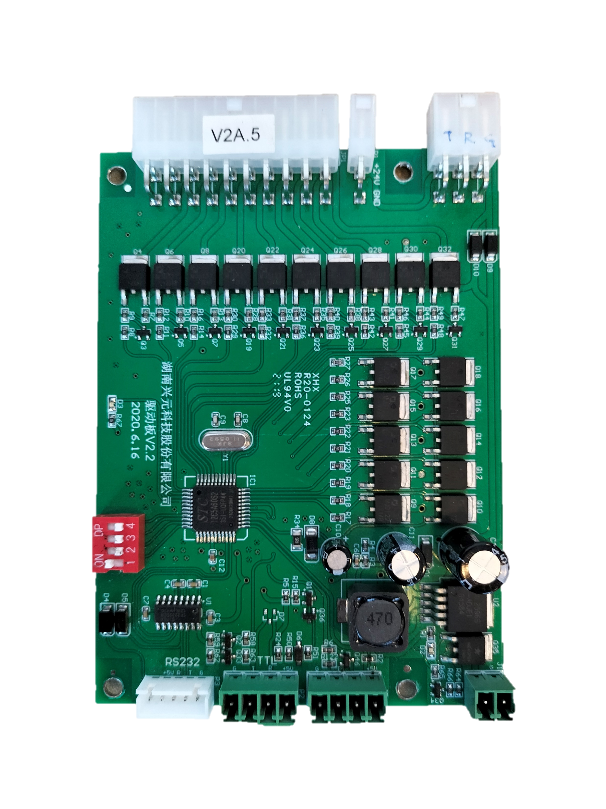
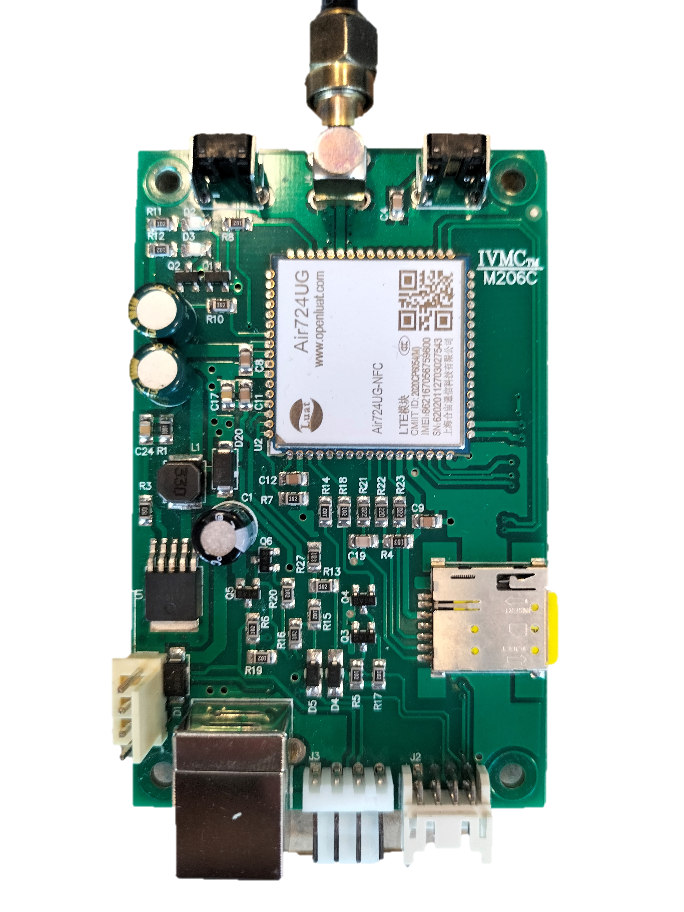
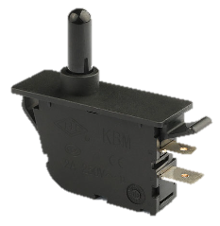
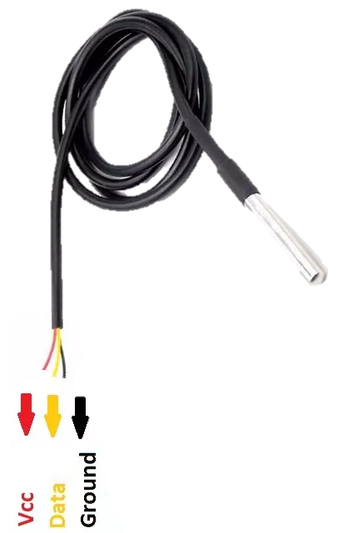
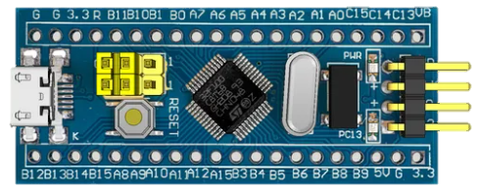
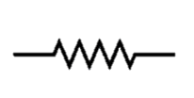
24V DC Power Supply
Motor Slots
Row
Column
24V
G
Drop Sensor
Door Switch
STC Board
DTU
NO
C
Temperature Sensor
Drive
G
G
S
24V G R T
D
5V
G T R 5V
Drive
G T 5V
24V G
G
DS18B20
STM32 Blue Pill
4.7kΩ

Slide 3
4G recv HI --> (request Drop status, temperature, Door Status)
List of Hex Commands and Returns https://docs.google.com/spreadsheets/d/1yvFmwiSHha0C8TX79S2l89XLynFGWwpFlRIR7rTtpHk/edit?usp=sharing

Slide 4
START
START
START
Ready to receive command
Ready to receive command
Send command
Receive command?
No
Receive command?
No
Yes
Yes
Receive command
Receive command
If command == motor status
No
If command == ‘A1’ –’10F’
Yes
If command == ‘A1’ –’10F’
No
Ready to receive string
Yes
Receive string?
No
No
Yes
Check motor status
Check motor status
If command == ‘HI’
No
Yes
No
Receive string
Yes
Motor available?
Ask STM32 to command for drop sensor status, temperature, door status
No
Yes
If command == drop sensor status
Motor ‘A1’ –’10F’ turns
Send info to MQTT
Send 6 bytes of Hex command
Yes
Check drop sensor status
Check drop sensor status
Ready to receive return Hex
Receive return Hex?
No
Drop sensor available?
No
Yes
Yes
Receive return Hex
Drop sensor detects item?
No
Send string value
Process
Yes
DTU
STM32
Send 5 bytes of return Hex
STC BOARD

